Slide 1
VSEPR THEORY
What does VSEPR stand for?
Valence Shell Electron Pair Repulsion

Slide 2
VSEPR THEORY
What does VSEPR mean?
VSEPR lets us determine the shape of covalent molecules and ions

Slide 3
VSEPR THEORY
Why is this important to know?
It explains how molecules and ions behave.

Slide 4
VSEPR THEORY
For example:
It explains why water molecules are so good at dissolving ionic substances even though water does not have an ionic bond.

Slide 5
VSEPR THEORY:
How do we determine the shapes of molecules and ions?

Slide 6
VSEPR THEORY:
Procedures to determine Geometry
1) Determine the central atom (usually the atom with the lowest electronegativity or the atom capable of forming the most bonds).

Slide 7
VSEPR THEORY:
Procedures to determine Geometry
2) Draw the electron dot structure
3) Determine the electronic geometry (based on the number of sites of electron density; steric number)
Electron density = all bonded atoms and unbonded electron pairs connected to the central atom

Slide 8
VSEPR THEORY:
Procedures to determine Geometry
4) Determine the molecular geometry (Accounting for all electron pairs and atoms bonded to the central atom)

Slide 9
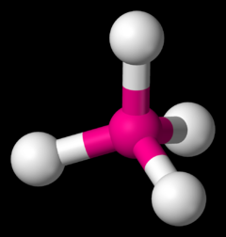
VSEPR THEORY
Common shapes you should know
Tetrahedral: Tetrahedral molecules look like pyramids with four faces. Each point on the pyramid corresponds to an atom that's attached to the central atom. Bond angles are 109.5 degrees.

Slide 10
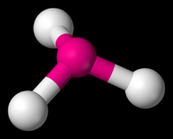
VSEPR THEORY
Trigonal pyramidal: It's like a tetrahedral molecule, except flatter. It looks kind of like a squished pyramid because one of the atoms in the pyramid is replaced with a lone pair. Bond angles are 107.5 degrees (it's less than tetrahedral molecules because the lone pair shoves the other atoms closer to each other).

Slide 11
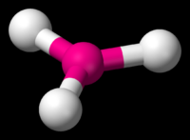
VSEPR THEORY
Trigonal planar: It looks like the hood ornament of a Mercedes automobile, or like a peace sign with that bottom-most line gone. The bond angles are 120 degrees.

Slide 12
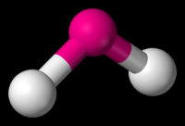
VSEPR THEORY
Bent: They look, well, bent. Bond angles can be either 118 degrees for molecules with one lone pair or 104.5 degrees for molecules with two lone pairs.

Slide 13
VSEPR THEORY
Linear: The atoms in the molecule are in a straight line. This can be either because there are only two atoms in the molecule (in which case there is no bond angle, as there need to be three atoms to get a bond angle) or because the three atoms are lined up in a straight line (corresponding to a 180 degree bond angle).

Slide 14
VSEPR THEORY: Example: BF₃
1) Central Atom?
→B (only 1 atom)

Slide 15
VSEPR THEORY: Example: BF₃
2) Electron Dot?
Remember that B violates the octet rule—this is an exception!
F B F F

Slide 16
VSEPR THEORY: Example: BF₃
3) Electronic Geometry?
Steric number?
Trigonal Planar
F B F F

Slide 17
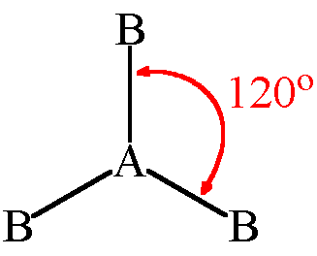
VSEPR THEORY: Example: BF₃
4) Molecular Geometry? Hint: What is the furthest apart you can spread three atoms attached to a central atom?
Trigonal Planar
F
B
F
F

Slide 18
VSEPR THEORY: Example: CH₄
1) Central Atom?
→C (only 1 atom)
2) Electron Dot?
H
H C H
H

Slide 19
VSEPR THEORY: Example: CH₄
3) Electronic Geometry?
Steric number?
Tetrahedral
H
H C H
H

Slide 20
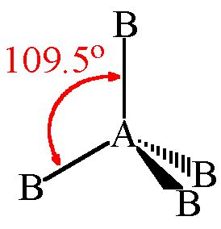
VSEPR THEORY: Example: CH₄
4) Molecular Geometry? Hint: What is the furthest apart you can spread four atoms attached to a central atom? Think in 3D!
Tetrahedral
H
C
H
H
H

Slide 21
VSEPR THEORY: Example: NH₃
1) Central Atom?
→N (only 1 atom)
2) Electron Dot?
H N H
H

Slide 22
VSEPR THEORY: Example: NH₃
3) Electronic Geometry?
Steric number?
Tetrahedral
H N H
H

Slide 23
VSEPR THEORY: Example: NH₃
4) Molecular Geometry? Hint: What is the furthest apart you can spread three atoms plus one unbonded pair of electrons attached to a central atom? Think in 3D!
Trigonal Pyramidal
~109.5º
N
H
H
H

Slide 24
VSEPR THEORY: Example: H₂O
1) Central Atom?
→O (only 1 atom)
2) Electron Dot?
O H
H

Slide 25
VSEPR THEORY: Example: H₂O
3) Electronic Geometry?
Steric number?
Tetrahedral
O H
H

Slide 26
VSEPR THEORY: Example: H₂O
4) Molecular Geometry? Hint: What is the furthest apart you can spread two atoms plus two unbonded pairs of electrons attached to a central atom? Think in 3D!
_{Bent}
~109.5º
O
H
H

